Slide 1

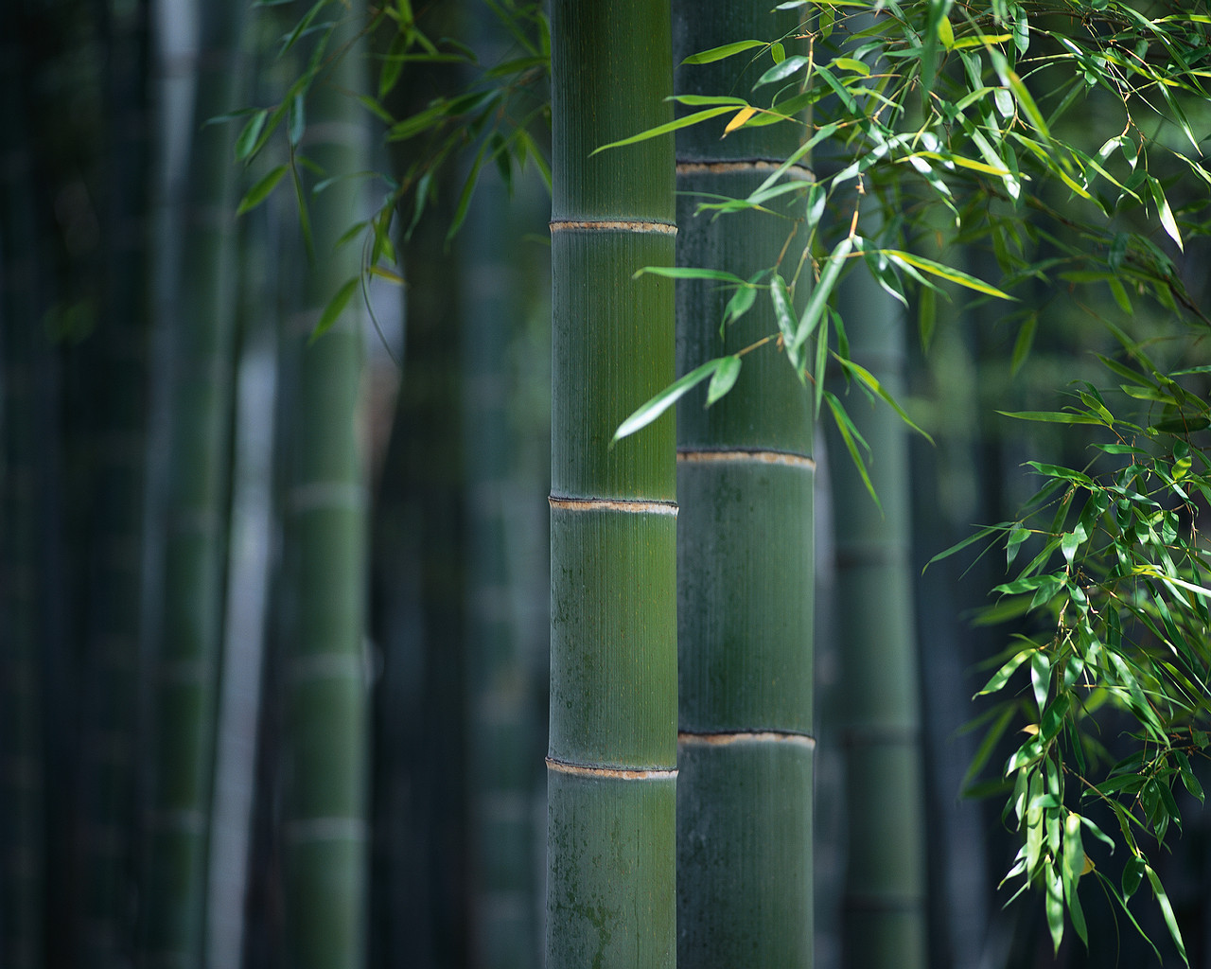

EIGHTH WORLD BAMBOO CONGRESS
THAILAND 2009

Slide 2

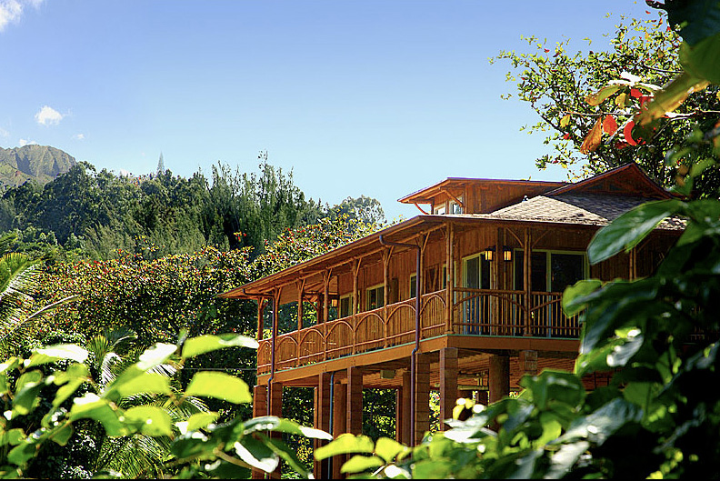
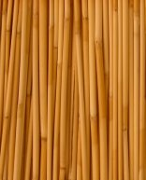

WHY ARE WE HERE?
The Importance of Building with Bamboo
Live in Your Values
July 2009

Slide 3
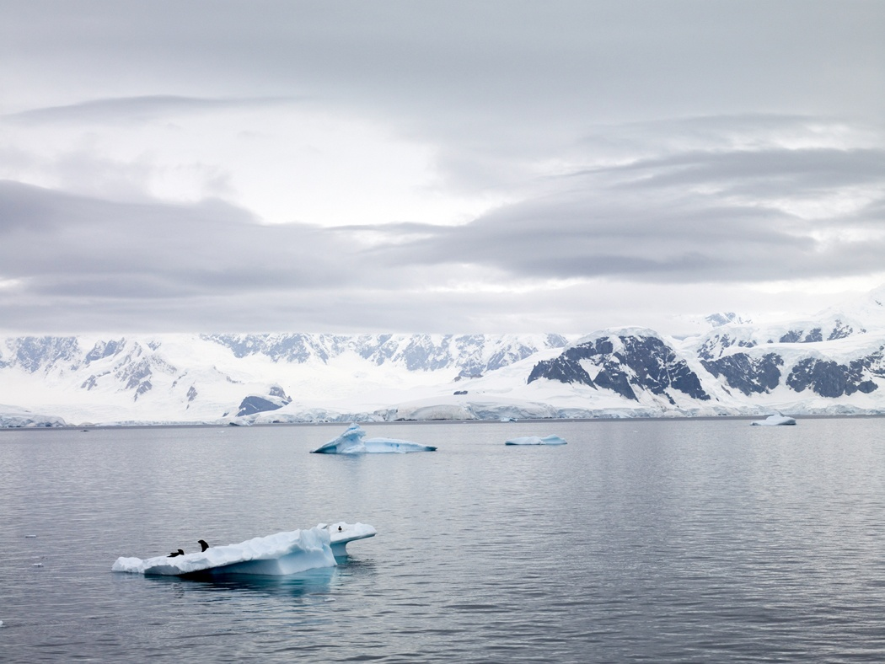
CLIMATE CHANGE
We have a Global Problem: CLIMATE CHANGE
Live in Your Values
July 2009

Slide 4
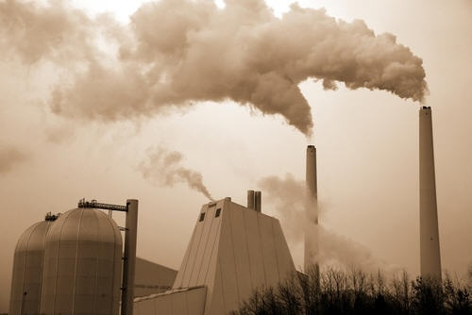
CLIMATE CHANGE
How many acres of bamboo would be required to sequester all of the greenhouse gas emissions of humankind throughout the entire world?
Live in Your Values
July 2009

Slide 5
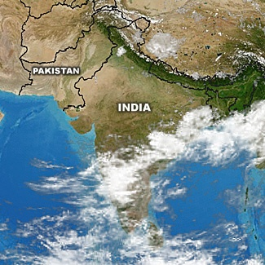
CLIMATE CHANGE
Based on one researcher’s analysis 425 million hectares if half monopodial and half sympodial.
Roughly the combined land area of India and Pakistan
That is a lot of land area
and a lot of research is
needed but . . .
Live in Your Values
July 2009

Slide 6

A CLIMATE CHANGE STRATEGY
Bamboo needs to be seriously explored as part of the climate solution.
Live in Your Values
July 2009

Slide 7
OUR CLIMATE CHANGE STRATEGY
Plantation Management
Biomass Production
Addressing bamboo flowering
Increasing Demand for bamboo
Durable bamboo goods
Biochar
Live in Your Values
July 2009

Slide 8
OUR CLIMATE CHANGE STRATEGY
Plantation Management
Harvest all poles on a regular cycle
to minimize loss to rot
Plant multiple species in each plantation
Manage existing wild bamboo forests
Live in Your Values
July 2009

Slide 9
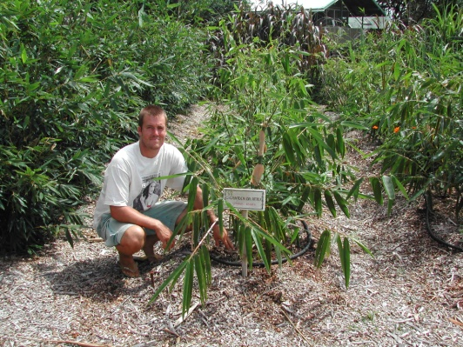
OUR CLIMATE CHANGE STRATEGY
Plantation Management
Live in Your Values
July 2009
Whispering Winds Bamboo Farm in Maui

Slide 10
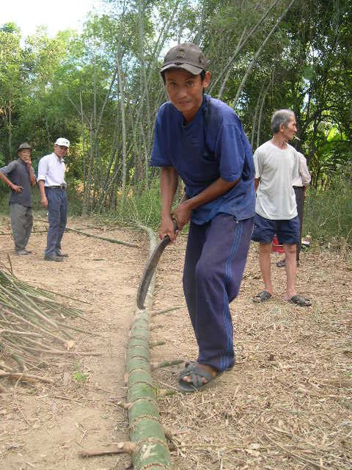
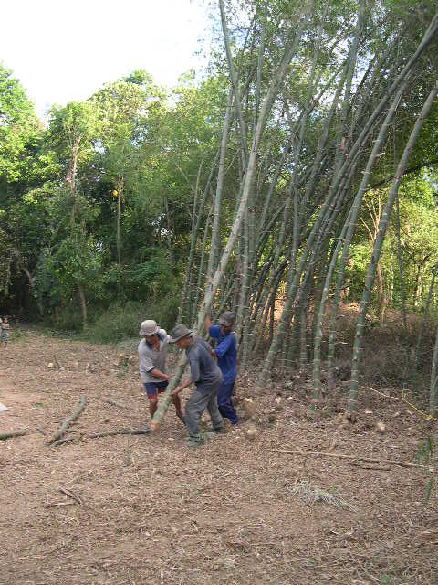
OUR CLIMATE CHANGE STRATEGY
Plantation Management
Live in Your Values
July 2009
Harvesting bamboo in Vietnam

Slide 11
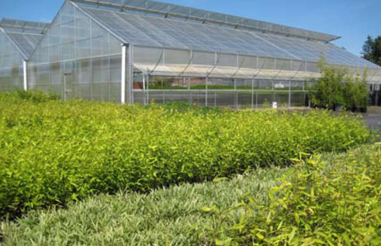
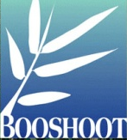
OUR CLIMATE CHANGE STRATEGY
Plantation Management
Bamboo Living Strategic Partner
Live in Your Values
July 2009
Booshoot, Mount Vernon Washington

Slide 12
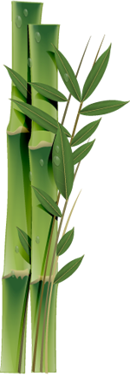
OUR CLIMATE CHANGE STRATEGY
Biomass Production
Potentially more than trees
Carbon uptake related to
biomass production
Needs further research for specific species in managed conditions
Live in Your Values
July 2009

Slide 13
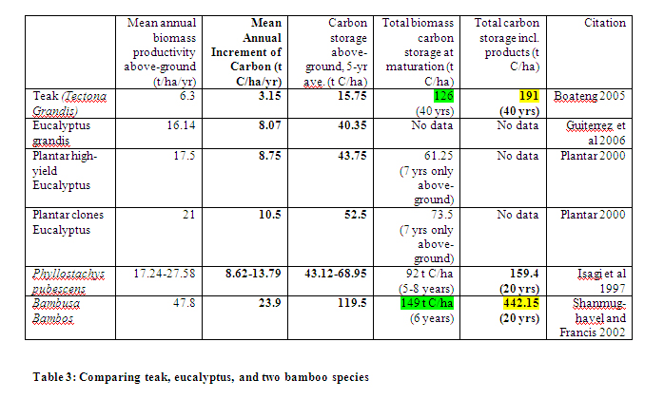
OUR CLIMATE CHANGE STRATEGY
Biomass Production
Live in Your Values
July 2009

Slide 14
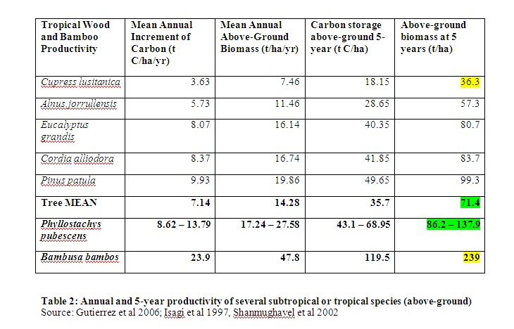
OUR CLIMATE CHANGE STRATEGY
Biomass production
Live in Your Values
July 2009

Slide 15
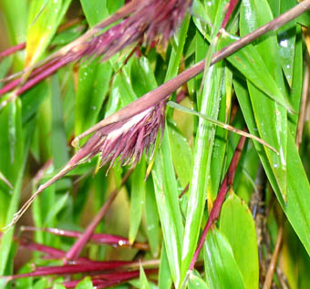
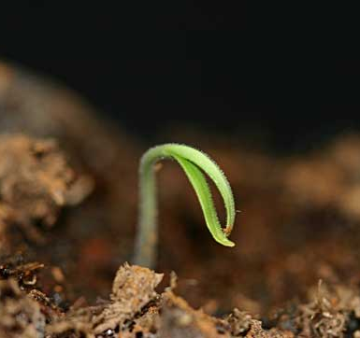
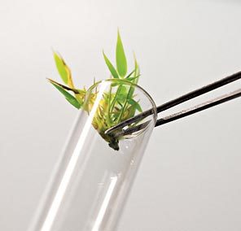
OUR CLIMATE CHANGE STRATEGY
Address bamboo flowering
Use seedling or recently seeded cultivars
to maximize growth time to flowering
Plant multiple species in each plantation to offset loss due to flowering.
Live in Your Values
July 2009

Slide 16
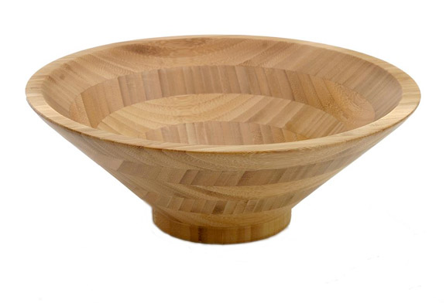
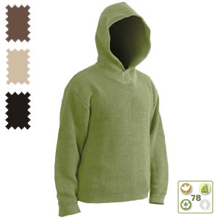
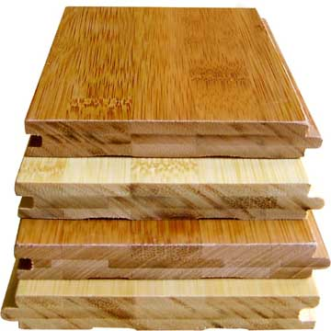
OUR CLIMATE CHANGE STRATEGY
Increasing Demand for Bamboo
Growing market
Broader range of durable products
Engineered bamboo materials
Supply chain management
Live in Your Values
July 2009

Slide 17
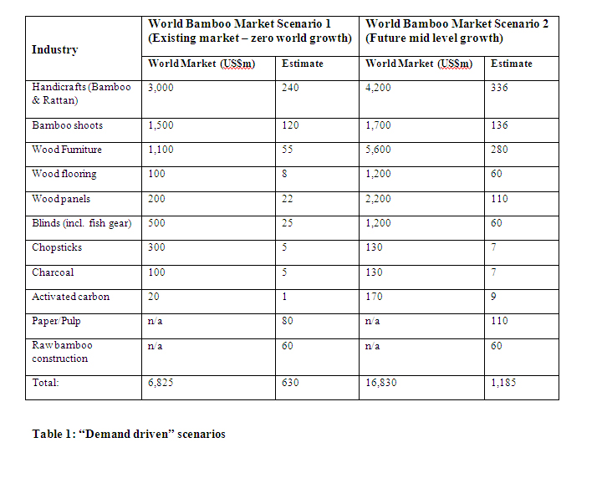
OUR CLIMATE CHANGE STRATEGY
Increasing Demand for Bamboo
Live in Your Values
July 2009

Slide 18
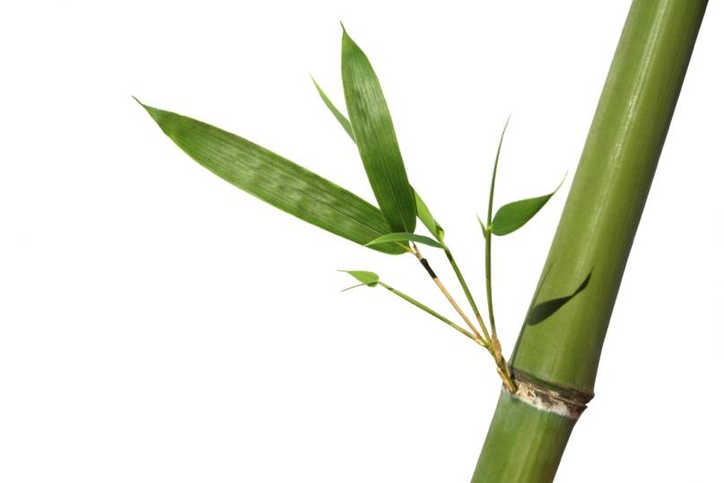
OUR CLIMATE CHANGE STRATEGY
Durable Bamboo Goods
Design buildings for durability
Design products for durability
Environmentally sustainable treatments
for durability
Live in Your Values
July 2009

Slide 19
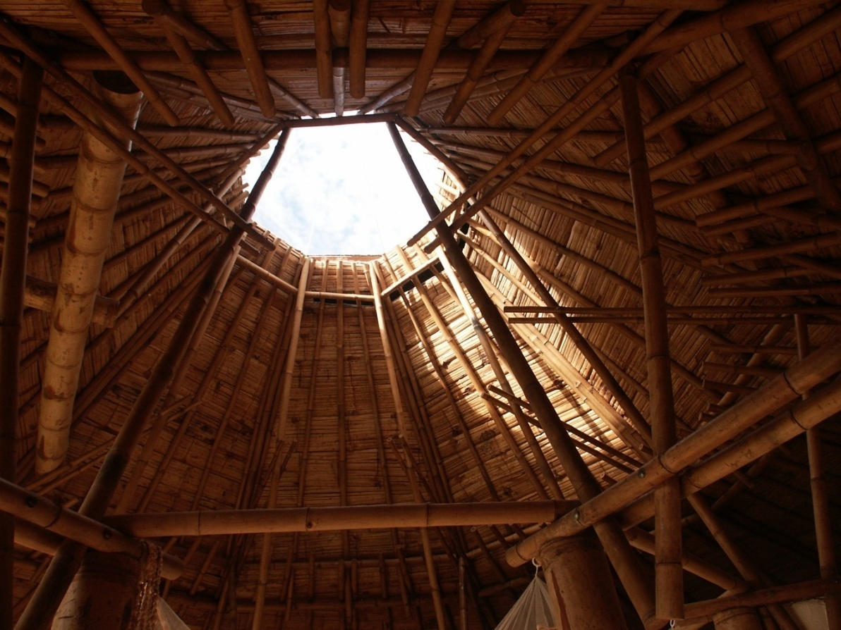
OUR CLIMATE CHANGE STRATEGY
Durable Bamboo Goods
First Bamboo Living Home

Slide 20
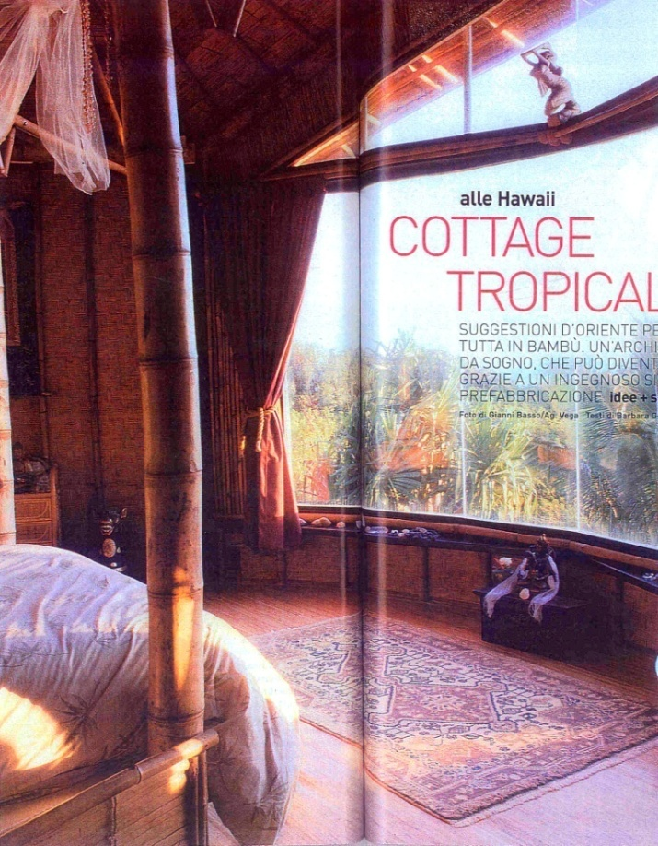
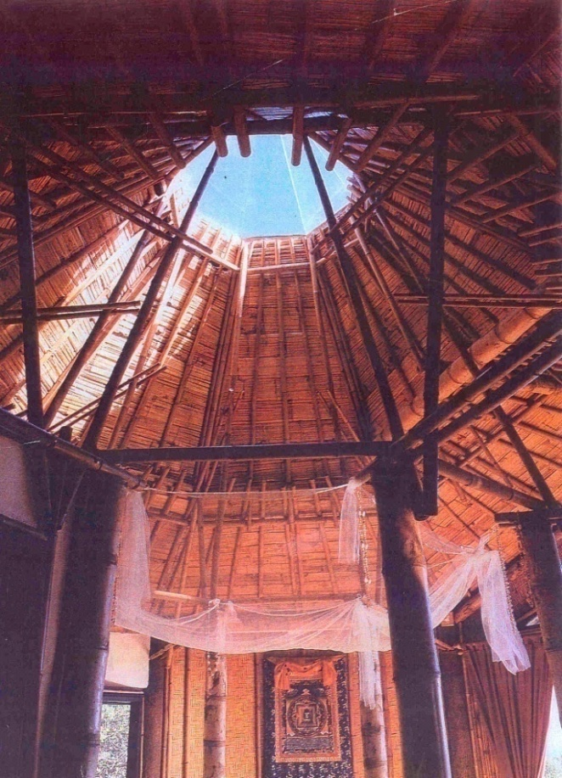
OUR CLIMATE CHANGE STRATEGY
Durable Bamboo Goods
First Bamboo Living Home

Slide 21
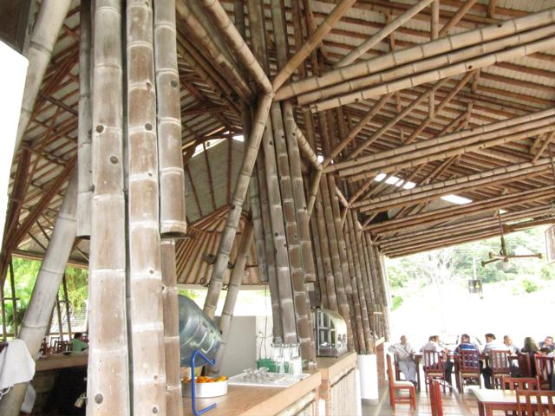
OUR CLIMATE CHANGE STRATEGY
Durable Bamboo Goods
Documented 25 year old bamboo structure designed by Simon Velez

Slide 22
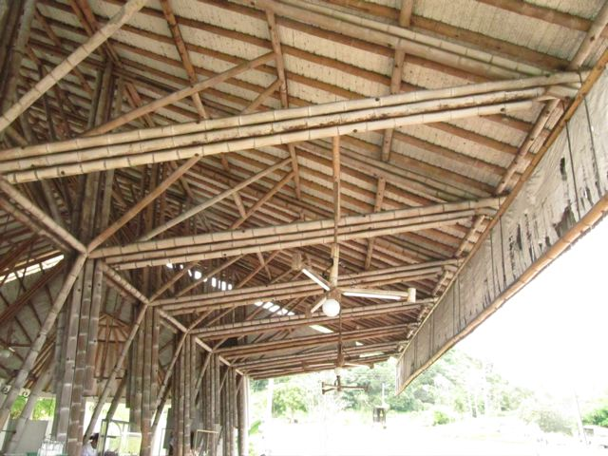
OUR CLIMATE CHANGE STRATEGY
Durable Bamboo Goods
25 Year Old Colombia Building

Slide 23
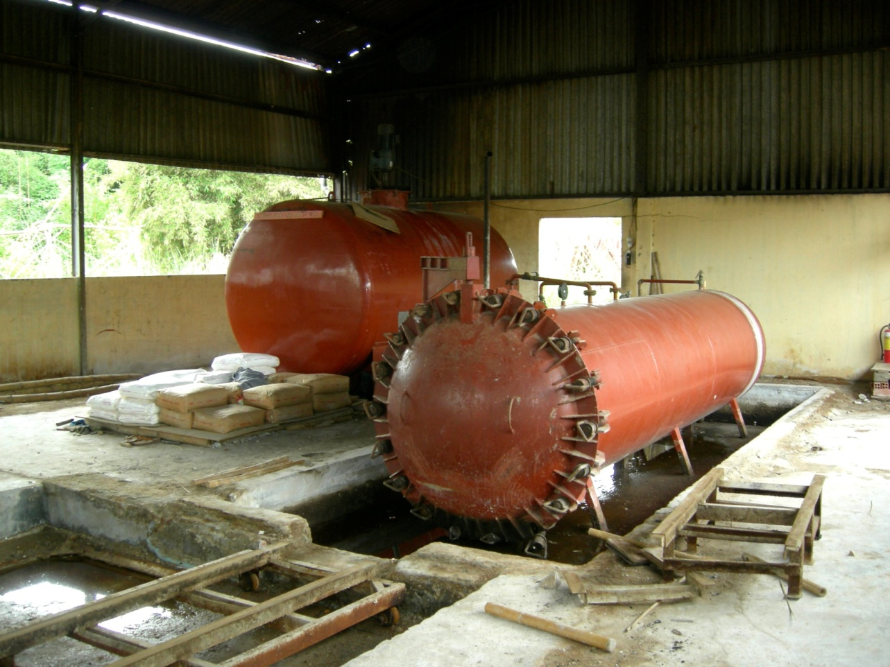
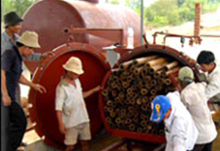
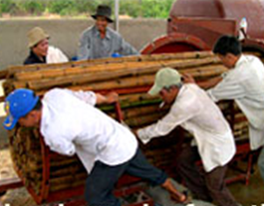
OUR CLIMATE CHANGE STRATEGY
Durable Bamboo Goods
Pressure treatment

Slide 24
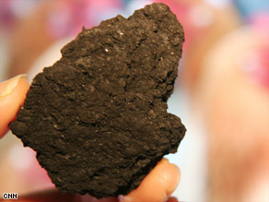
OUR CLIMATE CHANGE STRATEGY
Biochar
Handling Waste
Long Term Sequestration
Live in Your Values
July 2009

Slide 25
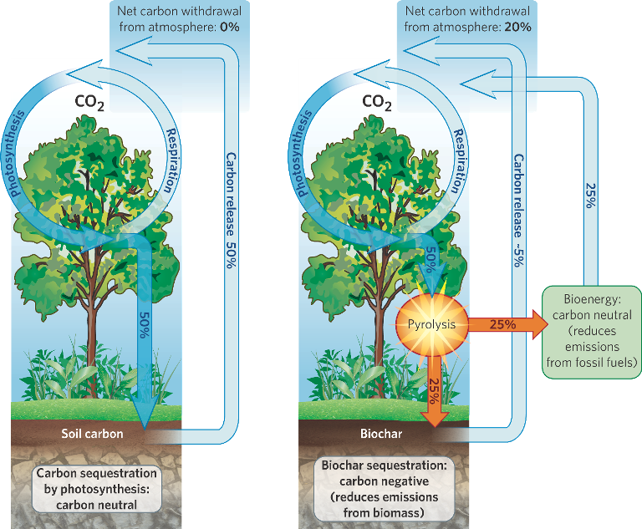
OUR CLIMATE CHANGE STRATEGY
How Biochar works
Live in Your Values
July 2009

Slide 26
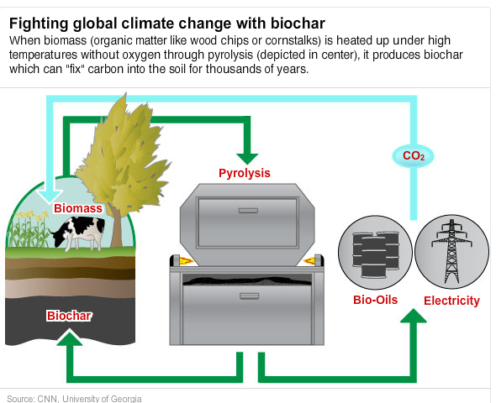
OUR CLIMATE CHANGE STRATEGY
Biochar & Global Climate
Live in Your Values
July 2009

Slide 27
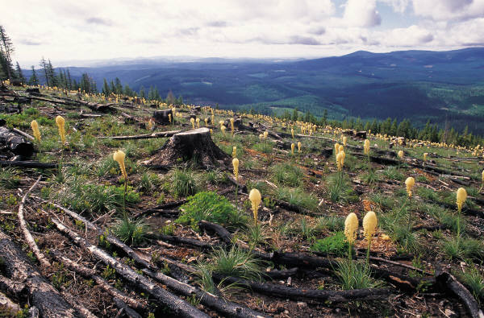
WHAT IF?
Think about how you can help.
Live in Your Values
July 2009

Slide 28
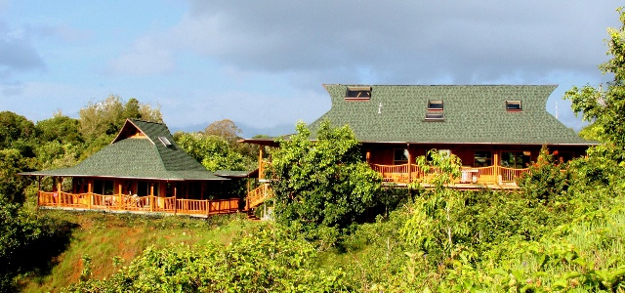
WHAT IF?
What if one house could sequester many tons of carbon?
Live in Your Values
July 2009

Slide 29
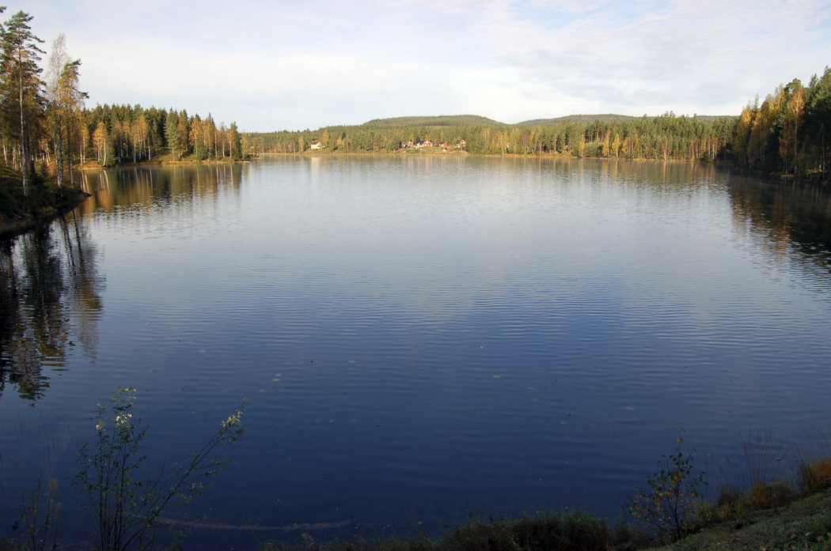
WHAT IF?
What if one house could help protect a watershed?
Live in Your Values
July 2009

Slide 30
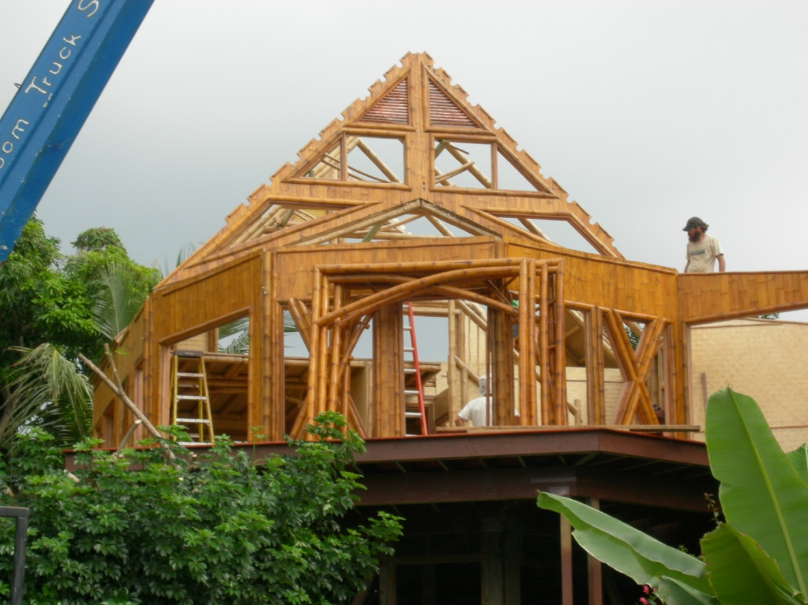
ONE HOUSE CAN!
One house can, if that house is made of bamboo.
Live in Your Values
July 2009

Slide 31
WHY BAMBOO?
Environmentally sustainable
Rehabilitation of degraded forest lands
Sequesters carbon
Prevents soil erosion
Protects watersheds
Improves the incomes of impoverished communities while conserving their environment
Live in Your Values
July 2009

Slide 32
WHY BAMBOO?
A Healthy Planet
Bamboo offers one of the fastest way to get carbon out of the atmosphere.
Building homes with bamboo sequesters the carbon for a hundred years.
Our homes are a carbon capture and storage system.
The Bamboo Commons model BC44, has sequestered in its fibers the carbon of 13.8 tons of CO2.
Who benefits? Every living being, large and small. And our planet Earth.
Live in Your Values
July 2009

Slide 33
WHY BAMBOO?
Strong and Safe
STRONG.
  Bamboo is an extremely strong fiber. It has twice the compression strength of concrete and roughly the same strength-to-weight ratio of steel in tension.
SAFE.
  Bamboo Living Homes withstood 3 hurricanes with winds at 173m.p.h. in the Cook Islands in Polynesia in 2005. Meanwhile, most of the wood frame houses on the island were damaged beyond repair.
BUILDING CODE APPROVED.
  Our homes are the first and only bamboo dwellings in the world that are built from structural bamboo under an ICC-ES Evaluation Report—the International Code Council.
Live in Your Values
July 2009

Slide 34
WHY BAMBOO?
Strong and Safe (cont’d)
WEATHER RESISTANT.
The exterior siding, overhangs and porches on our homes are coated with the highest quality water resistance finishes.
TERMITE AND MOLD RESISTANT.
Our bamboo houses are built from poles that are pressure treated with non-toxic borates to prevent termite and powder post beetle infestations as well as decay fungi.
INDOOR AIR QUALITY.
Indoor Air Quality (IAQ) of a home has a major impact on the long term health of its residents. Bamboo Living Homes ensures that all of the products it uses for treatments and finishes meet the highest IAQ standards.
Live in Your Values
July 2009

Slide 35
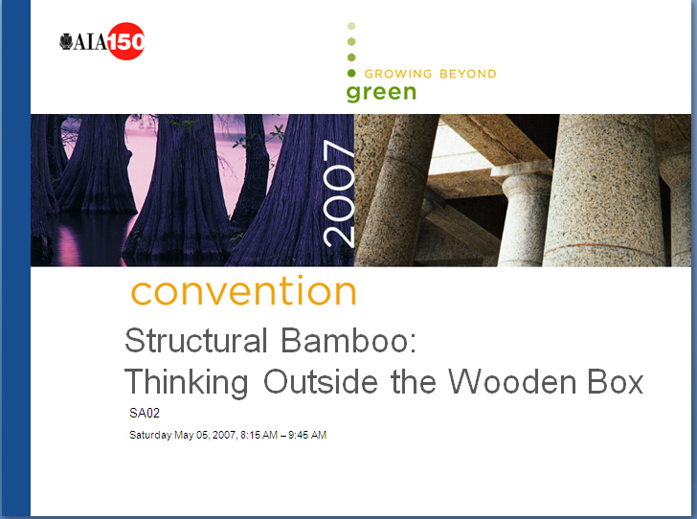
WHY BAMBOO?
AIA Presentation May 2007
Live in Your Values
July 2009

Slide 36
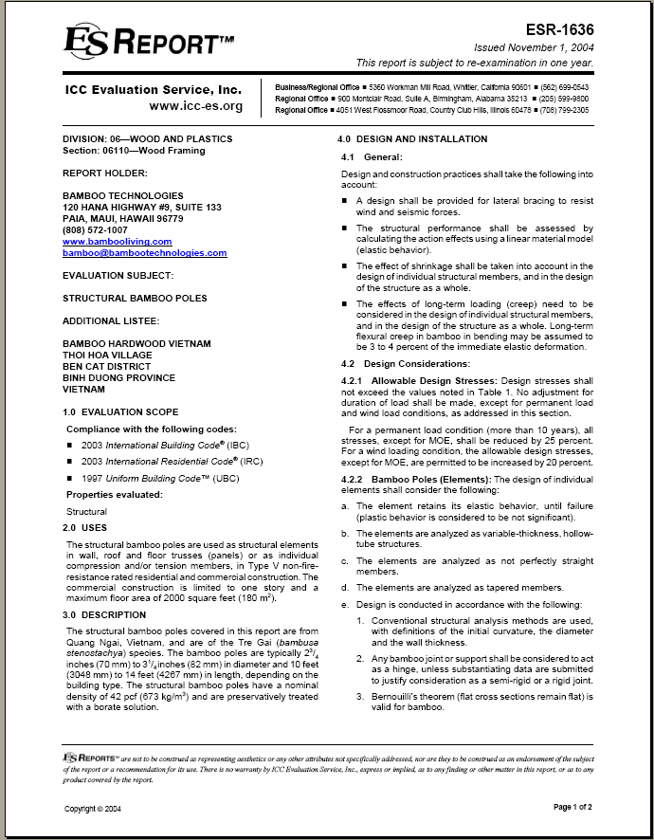
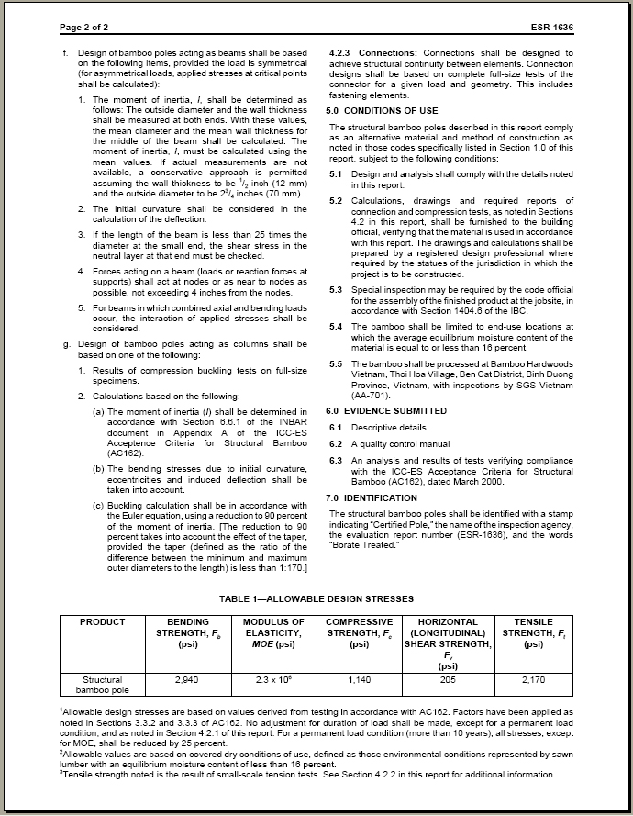
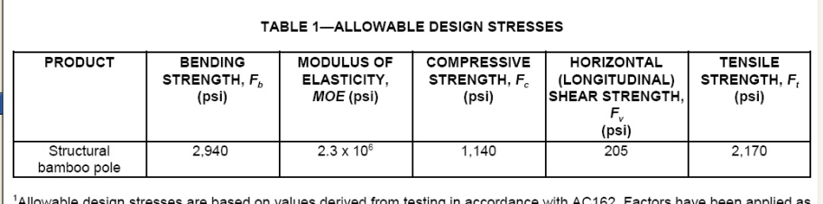
WHY BAMBOO?
ICC-ES Structural Bamboo Report (ICC ESR 1636)
Live in Your Values
July 2009

Slide 37
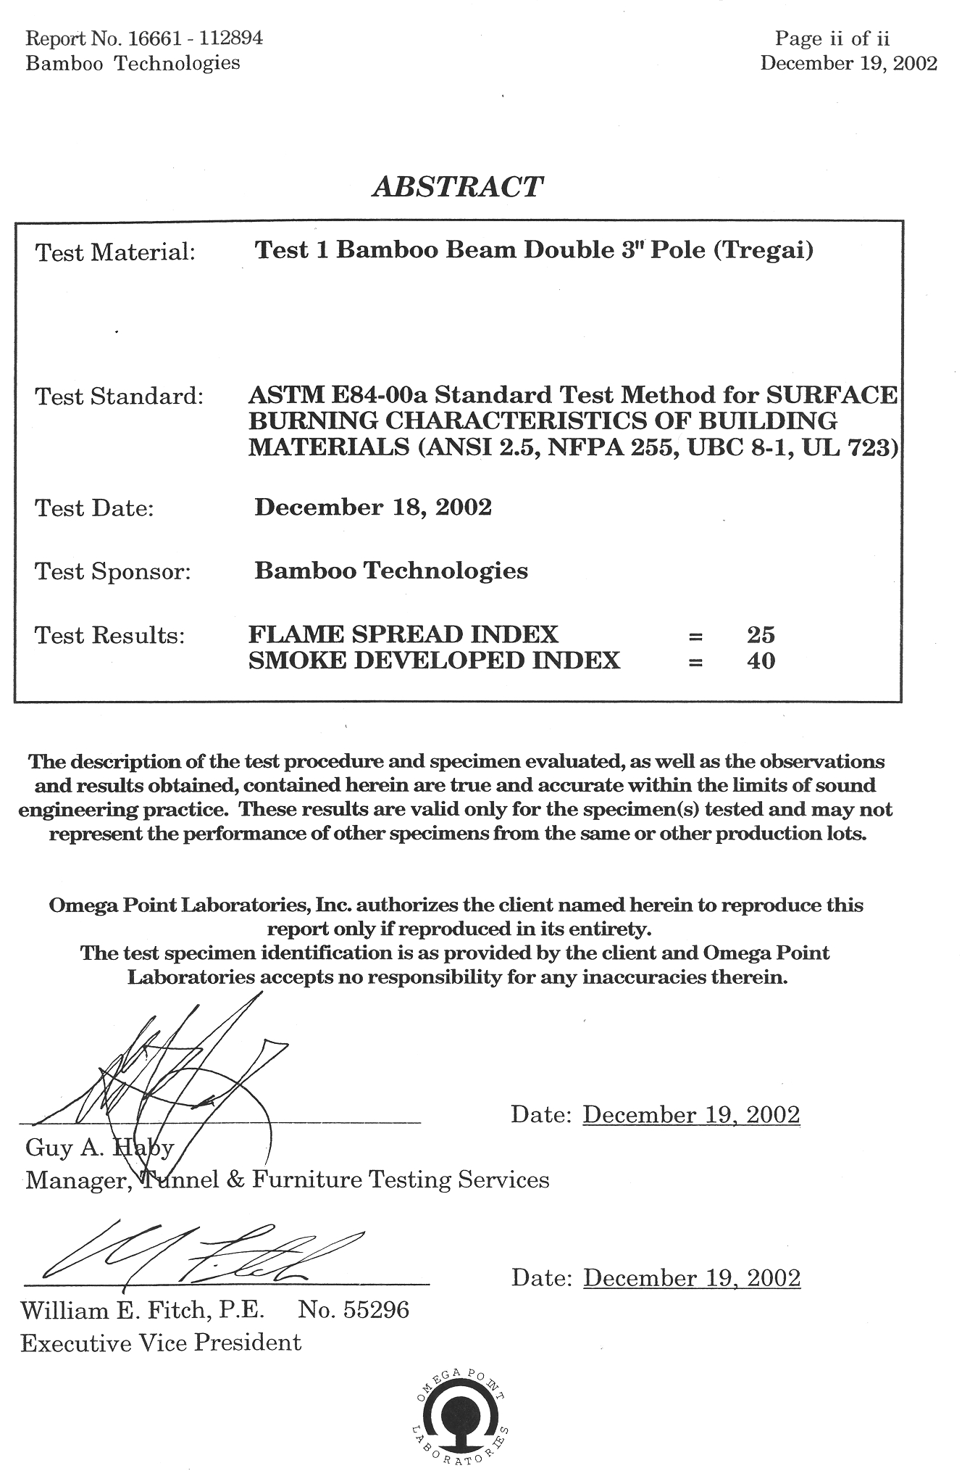
WHY BAMBOO?
Strong & Safe – Fire Testing Flame Spread
Bamboo
Flame Spread Index:
25
Smoke Developed Index:
40
Red Oak
Flame Spread Index:
100
Smoke Developed Index:
100
*Lower number indicates higher performance

Slide 38
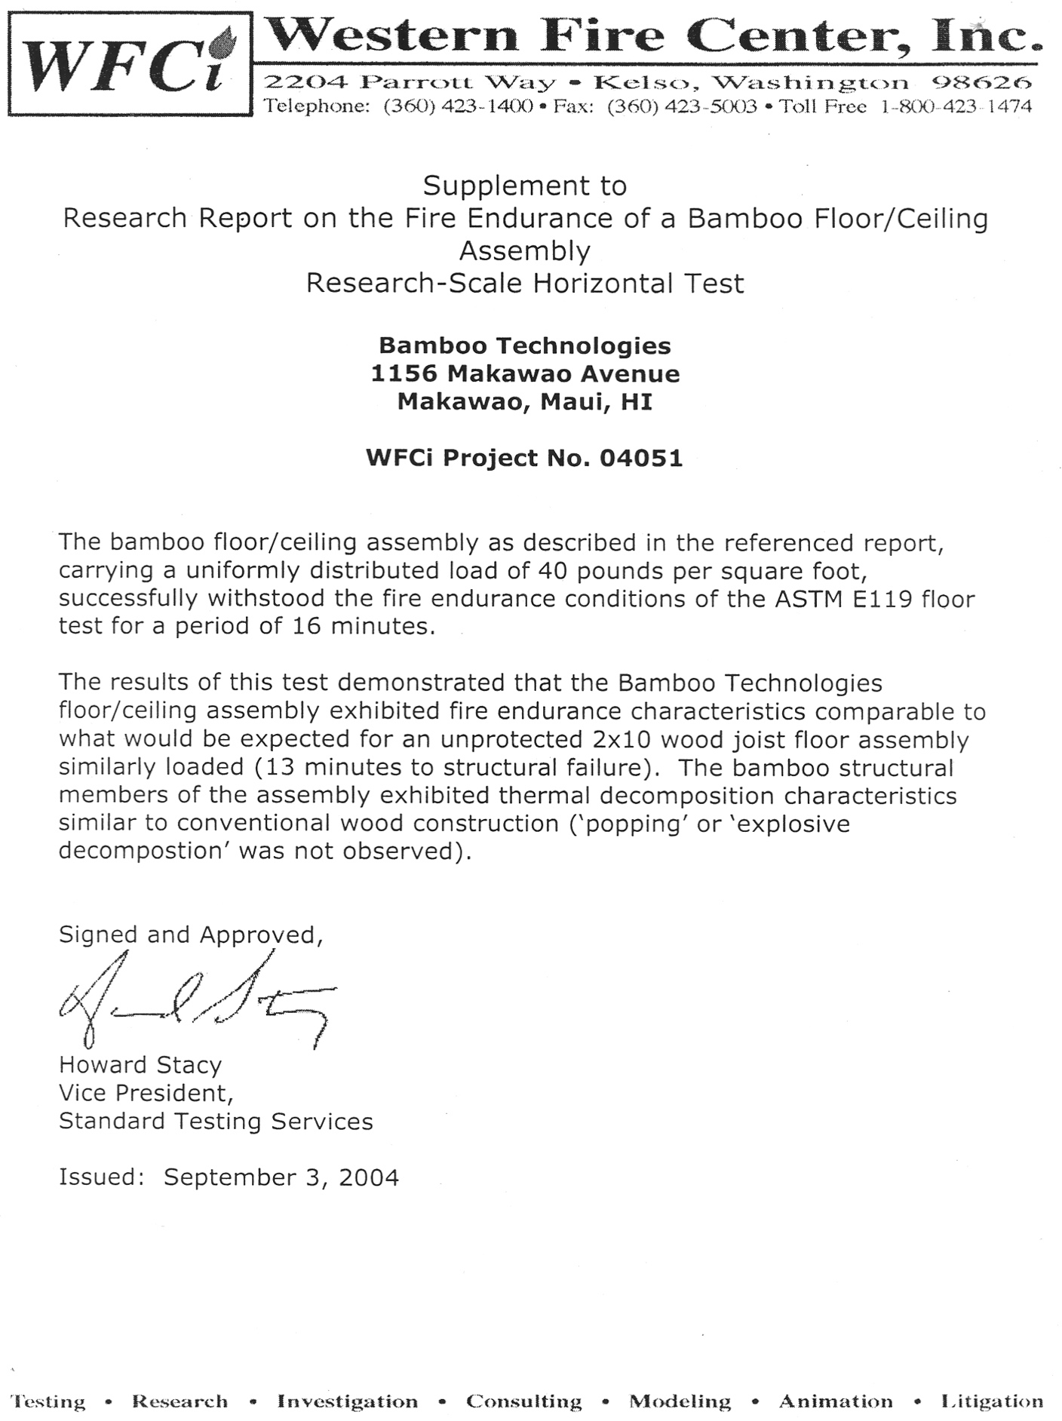
WHY BAMBOO?
Strong & Safe – Fire Endurance
Bamboo Floor System
16 minutes burning time to structural failure
2x10 Douglas Fir Floor System
13 minutes burning time to structural failure

Slide 39
WHY BAMBOO?
Insect Testing Protocol
Insects Used: Formosan Subterranean Termite (Coptotermes formosanus)
Termites harvested from a large, natural, healthy colony
ASTM 3345-74: Standard Method of Laboratory Evaluation of Wood and Other Cellulosic Materials for Resistance to Termites.
AWPA E1-97: Standard Method for Laboratory Evaluation to Determine Resistance to Subterranean Termites
Evaluation Criteria
Visual rating
Mass Loss
Mortality
Chemical Assay (if appropriate)
Live in Your Values
July 2009

Slide 40
WHY BAMBOO?
Insect Testing Protocol
Termite Harvest
Pine ‘bait’ inside cans, yield 500 to 1500 termites each
Counting Termites
360 Workers & 40 Soldiers
‘sucked-up’ one at a time.
Live in Your Values
July 2009

Slide 41
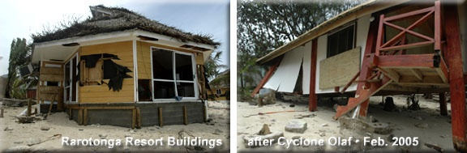
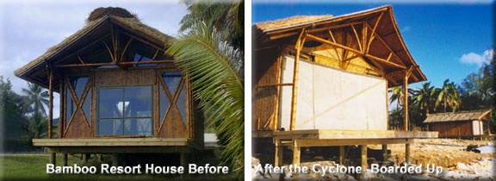
WHY BAMBOO?
Performance – Cyclone Olaf 1995
Wood
Buildings
Bamboo
Buildings

Slide 42
WHY BAMBOO?
Beyond Carbon:
Other Reasons Bamboo is Suited to the CDM
It must be harvested every 4-7 years, depending on species and uses, and should be harvested selectively. This means the carbon variation that would result from species that are usually clear cut is not a problem. The carbon pool should remain the same every five years at monitoring and verification – which simplifies the project methodology.
Selective harvesting actually increases the yield. In India it was shown that management of one species increased the annual yield by 20 times. (INBAR 2004)
Bamboo establishes rapidly after planting, with a mature stand usually reached within 4-6 years. Thus small and large investments pay-off quickly and provide communities with a source of raw materials for a variety of uses.
Live in Your Values
July 2009

Slide 43
WHY BAMBOO?
Beyond Carbon:
Other Reasons Bamboo is Suited to the CDM (cont’d)
Investments to start a bamboo plantation are likely to be lower than that for trees species
Bamboos can be grown on marginal, peripheral and non-cropped land or be intercropped or rotated with other species and crops.
Bamboo is an excellent and traditional livelihood development tool, which can be used for raw, semi-processed, or finished materials and sold on local, regional or international markets. Most wood species do not offer the same range of product possibilities and processing may require larger and more sophisticated facilities (INBAR 2004).
Live in Your Values
July 2009

Slide 44
WHY BAMBOO?
Bamboo Is the Future
Number 1
Bamboo is the #1 green alternative for building with timber.
Bamboo is the #1 fastest growing woody plant on earth – up to 24 inches a day.
Bamboo Living Homes are the first and only bamboo dwellings in the world that have achieved ICC-ES certification—the International Code Council.
Bamboo Living helped build the first American school building made of sustainable bamboo in Hana.
Live in Your Values
July 2009

Slide 45
WHY BAMBOO?
Bamboo Is the Future
Sustainable green construction is the fastest growing segment of the industry. According to the FMI 2008 US Construction Overview:
“Green, nonresidential construction put in place was $13.4 billion in 2006. By 2008, FMI predicts $21.2 billion of all new nonresidential construction will employ the use of green-building principles — a 58% increase. This sizable growth in green construction has created a shift in perception among owners and the architectural and engineering communities over the last few years — the industry is increasingly recognizing green-building capabilities as a necessary part of a firm’s best practices.”
Live in Your Values
July 2009

Slide 46
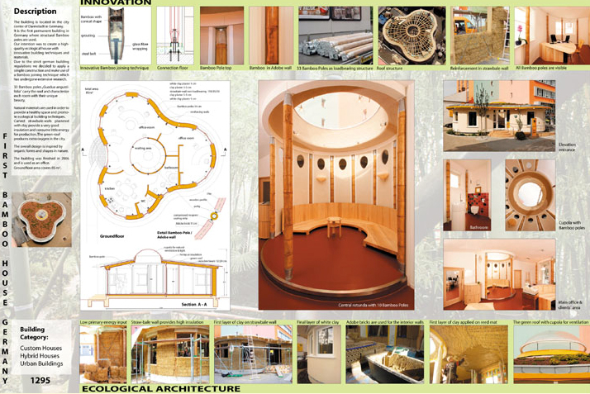
WHY BAMBOO?
Bamboo hybrid construction with local eco-sensitive materials worldwide
Live in Your Values
July 2009
Straw bale/Bamboo hybrid

Slide 47
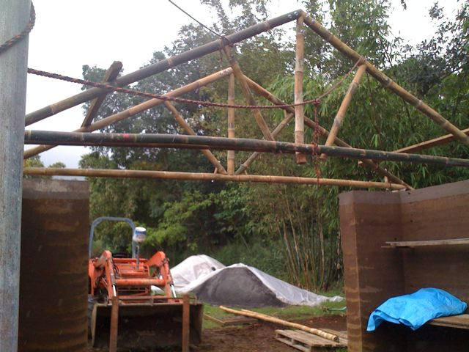
WHY BAMBOO?
Bamboo hybrid construction with local eco-sensitive materials worldwide
Live in Your Values
July 2009
Rammed earth/Bamboo hybrid

Slide 48
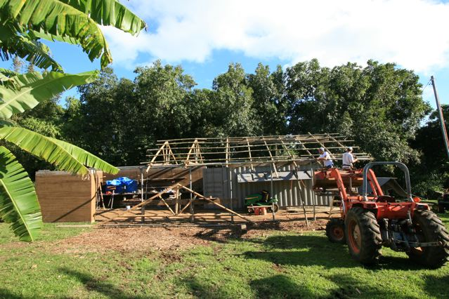
WHY BAMBOO?
Bamboo hybrid construction with local eco-sensitive materials worldwide
Live in Your Values
July 2009
Rammed earth/Bamboo hybrid

Slide 49

Our Bamboo Living Solution
From Plantation to Home

Slide 50
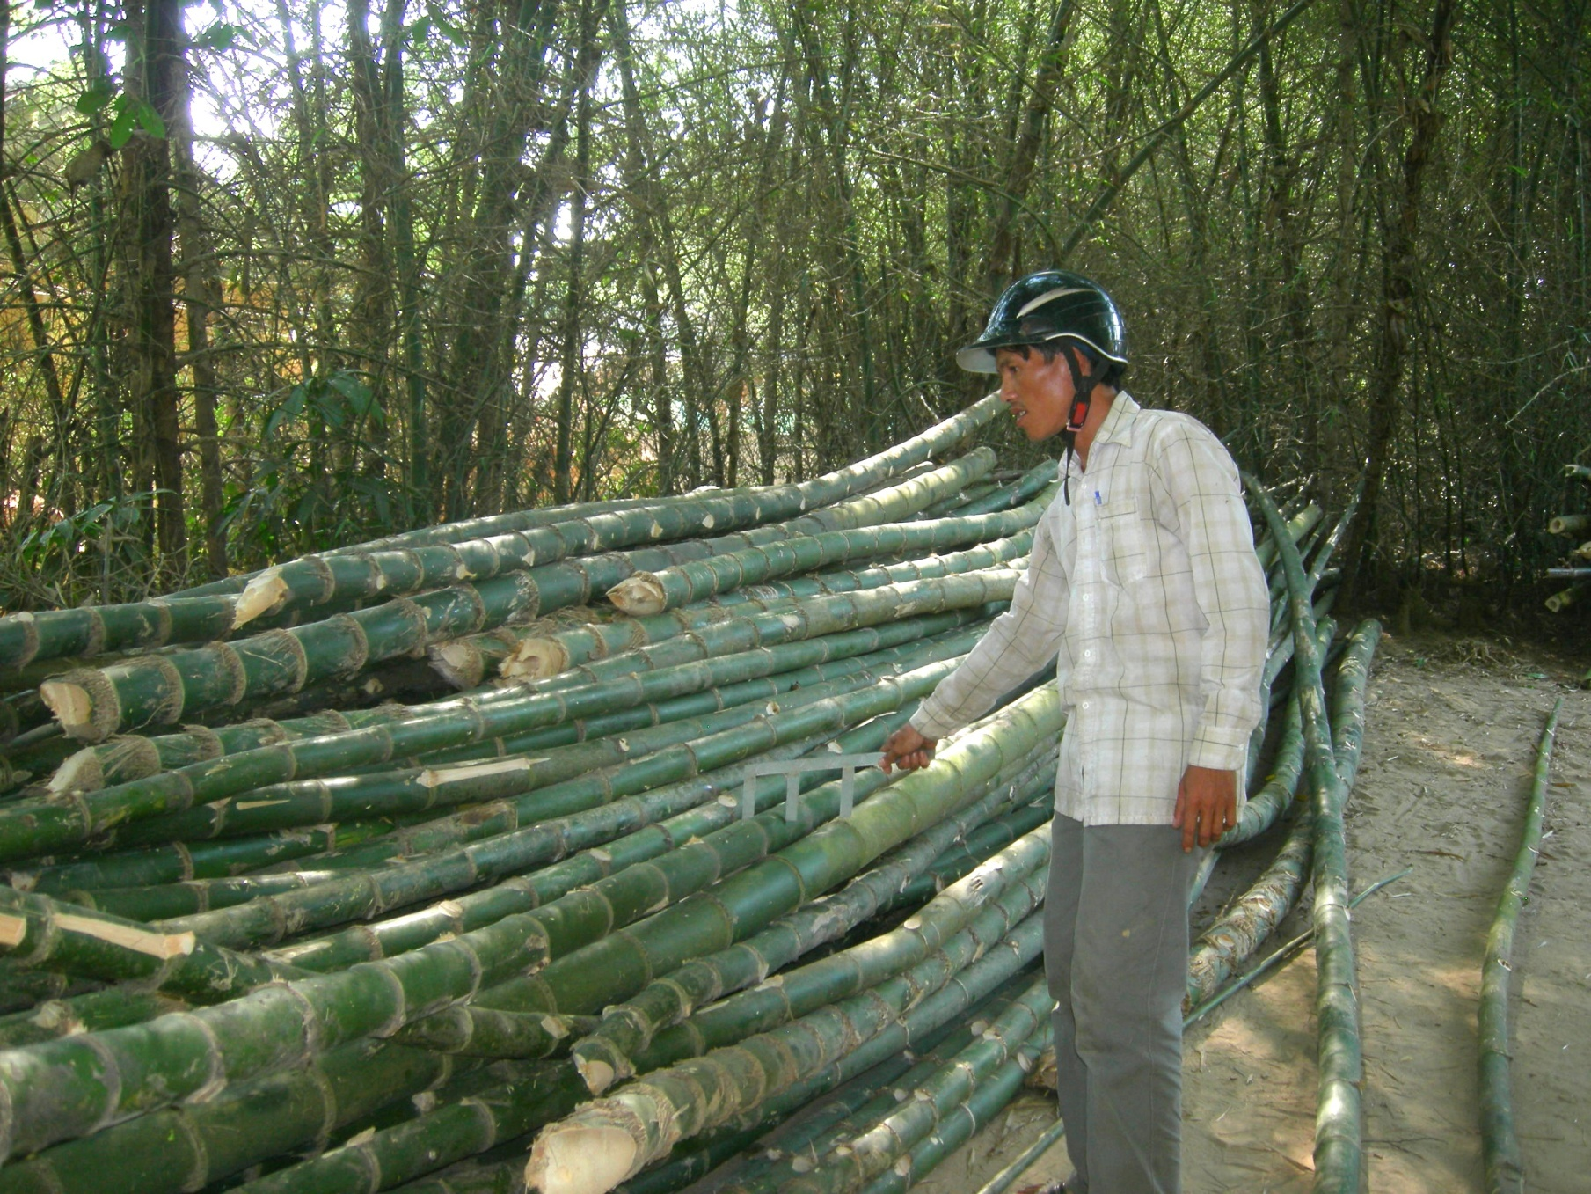
Bamboo Living: From plantation to home
Bamboo Living Plantation Vietnam

Slide 51
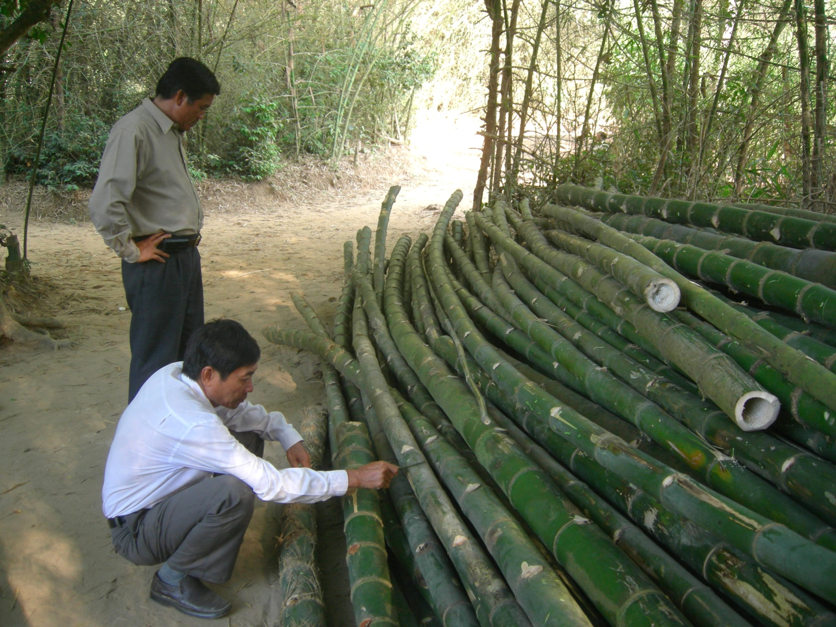
Bamboo Living: From plantation to home
Bamboo Living Factory Vietnam

Slide 52

Bamboo Living: From plantation to home
Bamboo Living Factory Vietnam

Slide 53

Bamboo Living: From plantation to home
Bamboo Living Factory Vietnam

Slide 54

Bamboo Living: From plantation to home
Bamboo Living Factory Vietnam

Slide 55

Bamboo Living: From plantation to home
Bamboo Living Factory Vietnam

Slide 56

Bamboo Living: From plantation to home
Bamboo Living Factory Vietnam

Slide 57

Bamboo Living: From plantation to home
Bamboo Living Factory Vietnam

Slide 58

Bamboo Living: From plantation to home
Bamboo Living Factory Vietnam

Slide 59

Bamboo Living: From plantation to home
Bamboo Living Factory Vietnam

Slide 60

Bamboo Living: From plantation to home
Bamboo Living Factory Vietnam

Slide 61

Bamboo Living: From plantation to home
Bamboo Living Factory Vietnam

Slide 62

Bamboo Living: From plantation to home
Bamboo Living Factory Vietnam

Slide 63

Bamboo Living: From plantation to home
Bamboo Living Factory Vietnam

Slide 64

Bamboo Living: From plantation to home
Bamboo Living Factory Vietnam

Slide 65

Bamboo Living: From plantation to home
Bamboo Living Factory Vietnam

Slide 66

Bamboo Living: From plantation to home
Bamboo Living Factory Vietnam

Slide 67

Bamboo Living: From plantation to home
Bamboo Living Factory Vietnam

Slide 68

Bamboo Living: From plantation to home
Bamboo Living Factory Vietnam

Slide 69

Bamboo Living: From plantation to home
Bamboo Living Factory Vietnam

Slide 70

Bamboo Living: From plantation to home
Bamboo Living Factory Vietnam

Slide 71

Bamboo Living: From plantation to home
Bamboo Living Factory Vietnam

Slide 72

Bamboo Living: From plantation to home
Bamboo Living Factory Vietnam

Slide 73

Bamboo Living: From plantation to home
Bamboo Living Factory Vietnam

Slide 74

Bamboo Living: From plantation to home
Bamboo Living Factory Vietnam

Slide 75

Bamboo Living: From plantation to home
Bamboo Living Factory Vietnam

Slide 76

Bamboo Living: From plantation to home
Bamboo Living Factory Vietnam

Slide 77

Bamboo Living: From plantation to home
Bamboo Living Factory Vietnam

Slide 78

Bamboo Living: From plantation to home
Bamboo Living Factory Vietnam

Slide 79

Bamboo Living Factory Vietnam

Slide 80

Bamboo Living Factory Vietnam

Slide 81

Bamboo Living Factory Vietnam

Slide 82

Bamboo Living Factory Vietnam

Slide 83

Hana House - Maui

Slide 84

Hana House - Maui

Slide 85

Hana House - Maui

Slide 86

Hana House - Maui

Slide 87

House Assembly

Slide 88

House Assembly

Slide 89

House Assembly

Slide 90

House Assembly

Slide 91

House Assembly

Slide 92

House Assembly

Slide 93

House Assembly

Slide 94

Hana High School

Slide 95

Hana High School

Slide 96

Hana High School

Slide 97

Hana High School

Slide 98

Hana High School

Slide 99

Oahu Beach House

Slide 100

Oahu Beach House

Slide 101

Oahu Beach House

Slide 102

Oahu Beach House

Slide 103

Oahu Beach House

Slide 104

Oahu Beach House

Slide 105

Ferrocement/Bamboo House

Slide 106

Ferrocement/Bamboo House

Slide 107

Ferrocement/Bamboo House

Slide 108

Ferrocement/Bamboo House

Slide 109

Ferrocement/Bamboo House

Slide 110

Ferrocement/Bamboo House

Slide 111




Bamboo Commons Collection
Our Most Economical Line
Exposed bamboo rafters
Vaulted ceilings
Painted/stucco ready exterior walls
Covered porch
10 available floor plans ranging from 400sf to 2480sf

Slide 112


David Sands Signature Collection
Artisan Quality.
Exposed bamboo rafters & vaulted ceilings
Split bamboo or paint/stucco ready exterior walls
Covered porch with bamboo railings
A wide range of floor plans from small bungalows to three bedroom homes

Slide 113



The Custom Bamboodist
The cross between Artisanship
and Technology.
Custom designed residence, resort, eco-village

Slide 114





BAMBOO LIVING AFFILIATIONS

Slide 115

Bamboo Living Factory Staff

Slide 116

Founders Jeffree Trudeau and David Sands

Slide 117
The Bamboo Living Team
extends support and gratitude
to all the organizers
and attendees here today.

Slide 118


www.bambooliving.com

